Slide 1

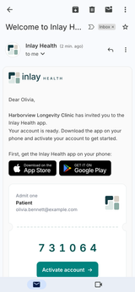
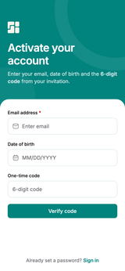
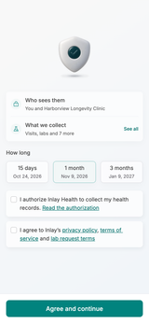
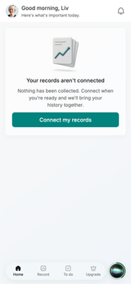
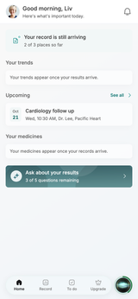
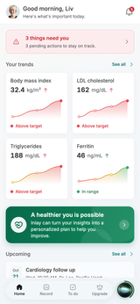
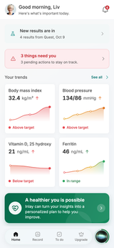
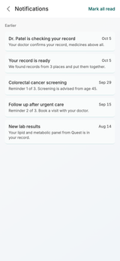
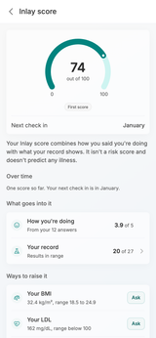
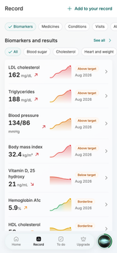
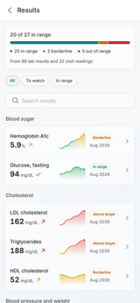
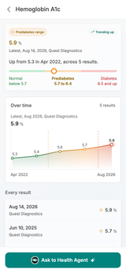
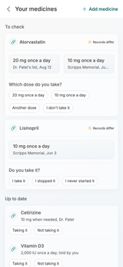
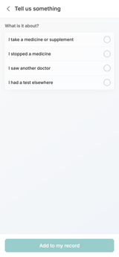
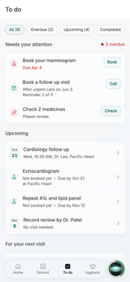
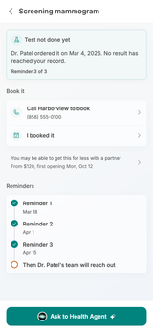
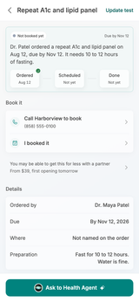
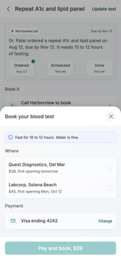
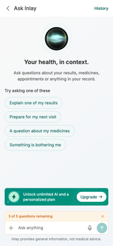
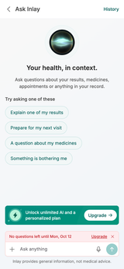
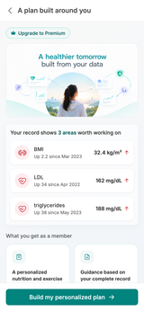
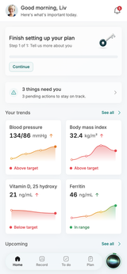
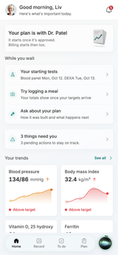
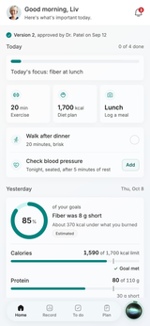
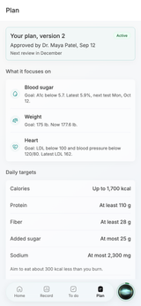
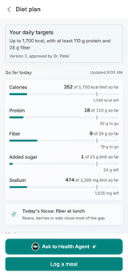
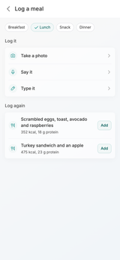
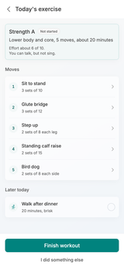
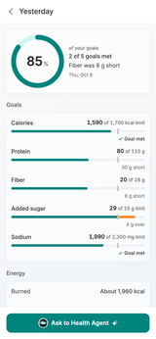
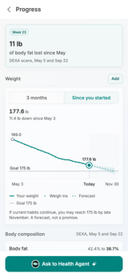
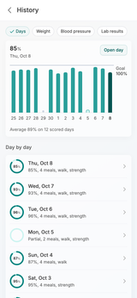
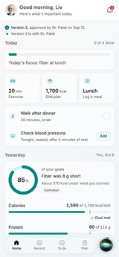
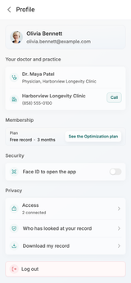
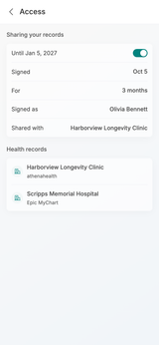
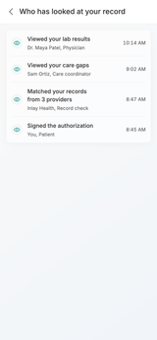
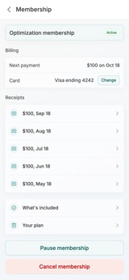
PATIENT MOBILE APP
The Patient App
Thirty-six screens, from the practice's invitation to the morning a member sees how yesterday went.
01 Invite and Activate
02 The Free Home
03 Your Record
04 To Do and Care Gaps
05 Ask Inlay and Optimization
06 Optimization Member
07 Profile and Control
36 screens · 7 stages
Internal discussion draft · October 2026
Screens captured from the live app build

Slide 2

The journey end to end
Seven stages. Inlay never asks the patient to do work the record can do, and their own physician stays in the loop.
01
02
03
04
05
06
07
INVITE AND ACTIVATE
THE FREE HOME
YOUR RECORD
TO DO AND CARE GAPS
ASK INLAY AND OPTIMIZATION
OPTIMIZATION MEMBER
PROFILE AND CONTROL
Every result, medicine and source in one place. Trends instead of snapshots, and the patient confirms what the hospitals disagree on.
Five screens from the practice's email to a record that builds itself. The patient types an email, a birthday and a code, then signs one consent.
The free record, in one screen each morning: what needs the patient, what is moving the wrong way, and help offered only where the record gives a reason.
Orders the doctor placed and the patient never finished. The app tracks each one from ordered to done, and Inlay can arrange the next step.
Nine screens a member uses every day: today's plan, yesterday's score, meals, exercise and measured progress, all under the physician's approved plan.
The patient owns the record: who sees it, for how long, who looked, and their membership, each one tap from Profile.
The assistant answers from the patient's own record, five questions a month on the free record. Optimization is built from that record too, and the physician approves it.
›
›
›
›
›
›
10
11
12
24
25
26
1
2
3
6
7
15
16
33
34
19
20
21
27
28
29
13
14
4
5
8
9
17
18
22
23
30
31
32
35
36
INLAY HEALTH · PATIENT MOBILE APP
OVERVIEW
2

Slide 3
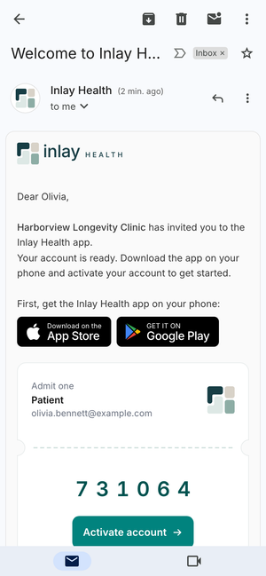

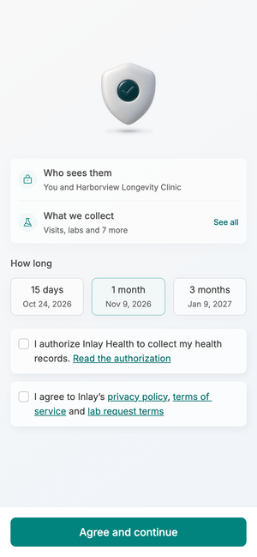
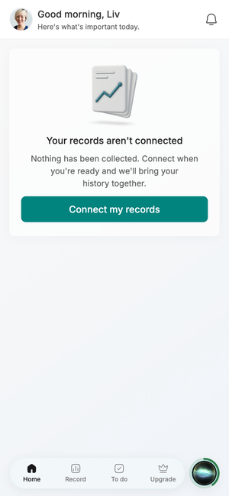

STAGE 01
Invite and Activate
Five screens from the practice's email to a record that builds itself. The patient types an email, a birthday and a code, then signs one consent.
1
2
3
Screens 1 to 5
4
5

Slide 4

01
STAGE 01 · INVITE AND ACTIVATE
Invitation Email
The practice sends it, not us
The patient hears about Inlay from their own clinic first. The email carries a code and one button, and nothing that could be phished or forwarded into trouble.
Harborview Longevity Clinic is named in the first line, so the invitation reads as their doctor's, not a stranger's
A 6-digit code, 731064, set on a ticket: no link to a password, no ID, no health data in the email
App Store and Google Play badges come before the code, because the app has to be installed before activation can start
INLAY HEALTH · PATIENT MOBILE APP
SCREEN 1 OF 36
4

Slide 5

02
STAGE 01 · INVITE AND ACTIVATE
Activate Your Account
Three fields, then you're in
Activation asks only what the practice already knows. Email, date of birth and the code prove identity without a form to fill in.
Email, date of birth and one-time code: three fields that match the invite to the person holding the phone
"Verify code" is the only button; "Already set a password? Sign in" sits quietly at the foot
Large type and generous fields for a patient population that skews around sixty
INLAY HEALTH · PATIENT MOBILE APP
SCREEN 2 OF 36
5

Slide 6

03
STAGE 01 · INVITE AND ACTIVATE
Consent
One consent, before anything else
Consent is the first real screen inside the app, because it is what starts the record pull. Everything the patient needs to decide sits above one button.
"Who sees them: you and Harborview Longevity Clinic" answers the first worry before it is asked
How long is a choice, not fine print: 15 days, 1 month or 3 months, each with its end date
Two checkboxes, authorization and terms, then "Agree and continue"; nothing else competes
INLAY HEALTH · PATIENT MOBILE APP
SCREEN 3 OF 36
6

Slide 7
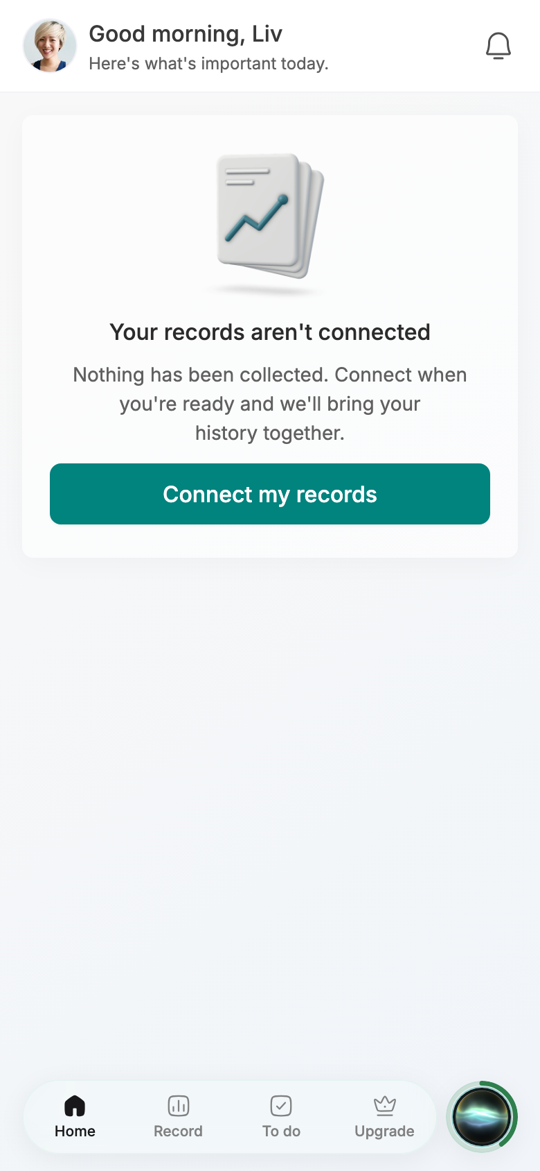
04
STAGE 01 · INVITE AND ACTIVATE
Records Not Connected
Saying no costs nothing
A patient who skips consent still lands on a working home. The screen states plainly that nothing was collected and leaves one way back in.
"Nothing has been collected" is the reassurance the cautious patient needs to come back later
"Connect my records" is the single action, and the tab bar stays live around it
No warnings, no nagging banner: the empty state carries the whole argument for connecting
INLAY HEALTH · PATIENT MOBILE APP
SCREEN 4 OF 36
7

Slide 8
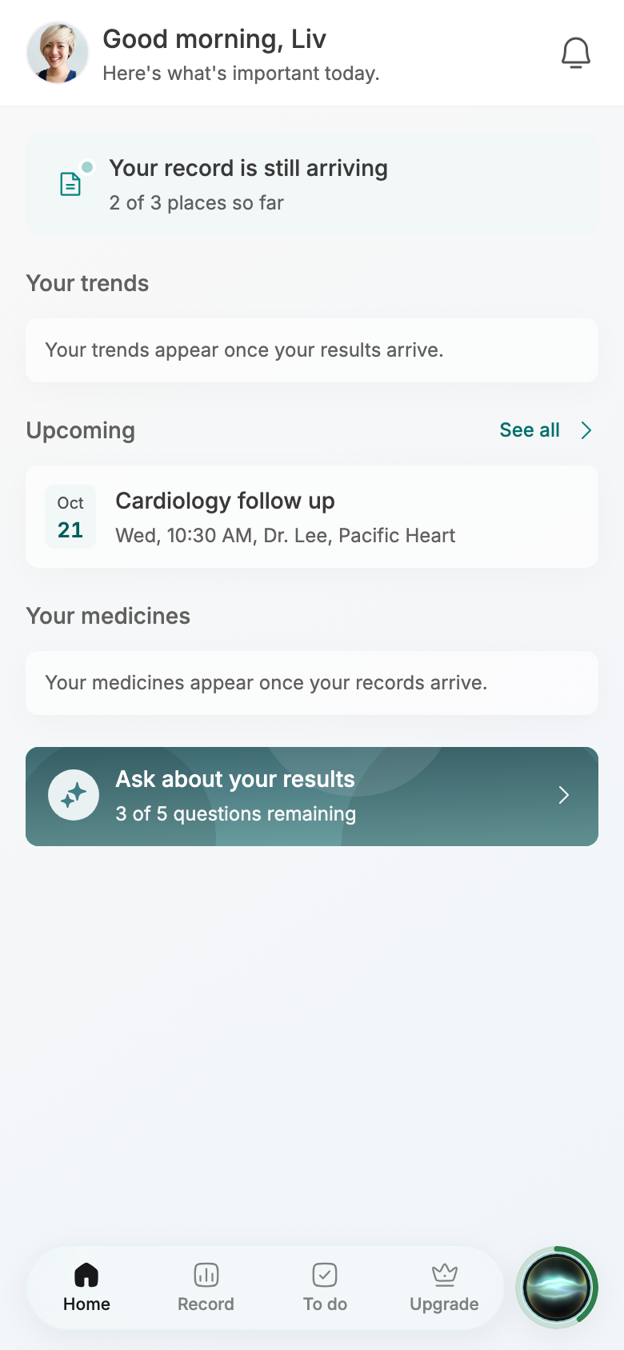
05
STAGE 01 · INVITE AND ACTIVATE
Record Arriving
Useful before it's complete
The record fills in while the patient watches. Home shows what has arrived and holds a calm place for what has not.
"Your record is still arriving, 2 of 3 places so far" sets honest expectations without a spinner
The Cardiology follow up on Oct 21 already shows, so the first visit has value
Ask Inlay is offered at once, with "3 of 5 questions remaining" visible from the start
INLAY HEALTH · PATIENT MOBILE APP
SCREEN 5 OF 36
8

Slide 9
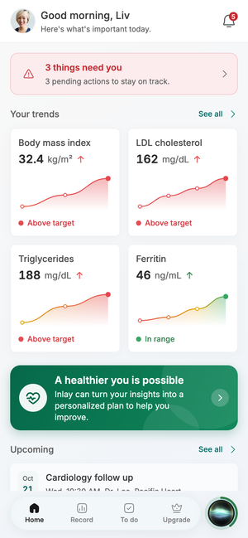
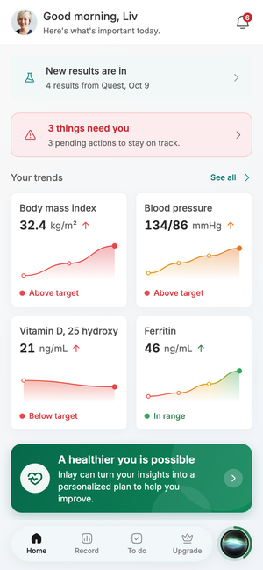
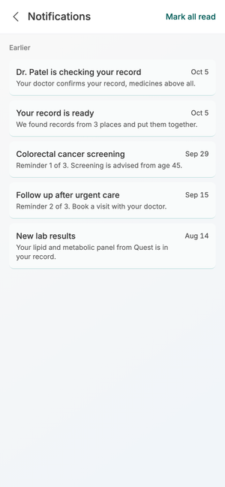
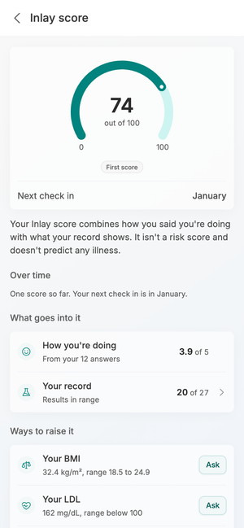
STAGE 02
The Free Home
The free record, in one screen each morning: what needs the patient, what is moving the wrong way, and help offered only where the record gives a reason.
Screens 6 to 9
6
7
8
9

Slide 10
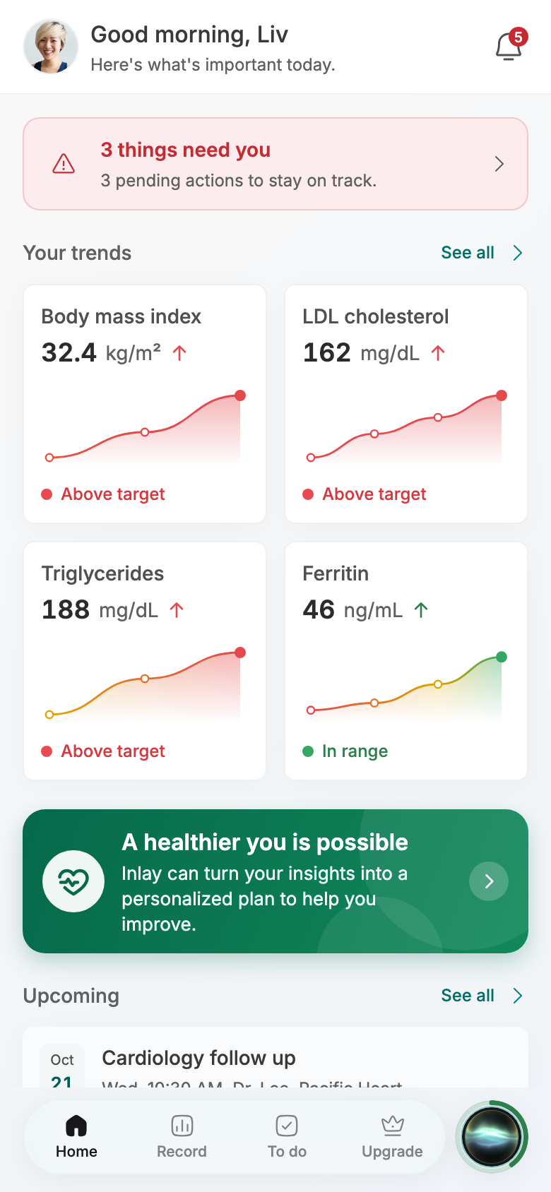
06
STAGE 02 · THE FREE HOME
Home
What's important today
Home opens on what needs the patient and what is changing. Trends come first; the invitation to Optimization sits after them, beside the evidence that prompted it.
"3 things need you" in muted red is the first card, so nothing urgent hides below the fold
Four trend tiles with dots and colour per reading: BMI 32.4, LDL 162 and triglycerides 188 above target, ferritin 46 in range
"A healthier you is possible" follows the trends: help is offered where the reason for it is already on screen
INLAY HEALTH · PATIENT MOBILE APP
SCREEN 6 OF 36
10

Slide 11

07
STAGE 02 · THE FREE HOME
New Results
News goes on top
When new results land, home says so before anything else. The patient learns what came in, from where and when, in one line.
"New results are in: 4 results from Quest, Oct 9" leads the screen, above the attention card
The trend tiles update with the news: blood pressure 134/86 and vitamin D 21 below target now appear
The bell badge climbs to 6, so the change is visible even before the patient scrolls
INLAY HEALTH · PATIENT MOBILE APP
SCREEN 7 OF 36
11

Slide 12

08
STAGE 02 · THE FREE HOME
Notifications
Every reminder, counted
One list for everything the app has told the patient. Each item says what happened and, for reminders, how many have been sent.
"Dr. Patel is checking your record" tells the patient a real physician is looking, not a system
Reminders are numbered, "Reminder 1 of 3" and "Reminder 2 of 3", so the escalation is never a surprise
"Your record is ready: we found records from 3 places" closes the onboarding loop in plain words
INLAY HEALTH · PATIENT MOBILE APP
SCREEN 8 OF 36
12

Slide 13

09
STAGE 02 · THE FREE HOME
Inlay Score
A score, not a verdict
The Inlay score combines how the patient says they are doing with what the record shows. It explains itself and says what it is not.
74 out of 100, marked "First score", with the next check in January
Two inputs on view: how you're doing at 3.9 of 5 from 12 answers, and 20 of 27 results in range
"It isn't a risk score and doesn't predict any illness" sits on the page; "Ways to raise it" pairs BMI and LDL with Ask
INLAY HEALTH · PATIENT MOBILE APP
SCREEN 9 OF 36
13

Slide 14
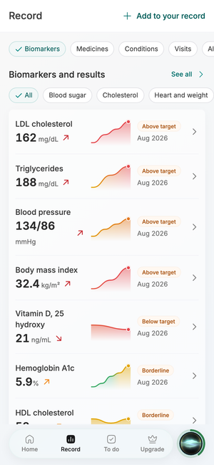
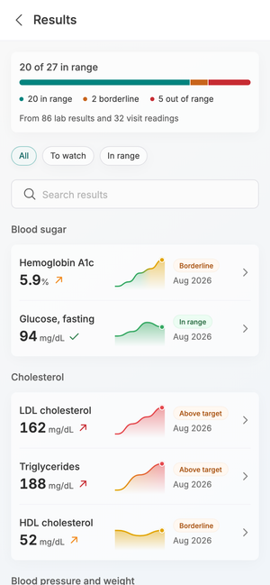

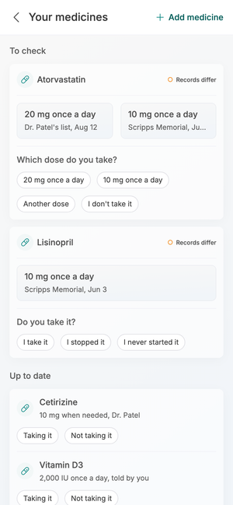
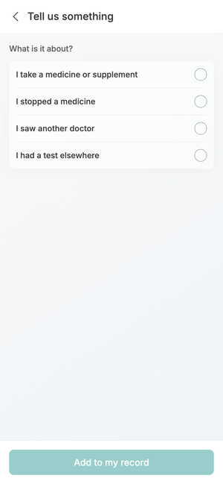
STAGE 03
Your Record
Every result, medicine and source in one place. Trends instead of snapshots, and the patient confirms what the hospitals disagree on.
10
11
12
Screens 10 to 14
13
14

Slide 15

10
STAGE 03 · YOUR RECORD
Record
The whole record, filtered
The Record tab gathers results, medicines, conditions and visits from every source. Category pills and body system chips narrow it without a menu.
Biomarkers, Medicines, Conditions, Visits as pills; Blood sugar, Cholesterol, Heart and weight as chips beneath
Each row shows name, big value, trend line, status and date: LDL 162, Above target, Aug 2026
"Add to your record" sits in the header, so self-reported tests and supplements have a home
INLAY HEALTH · PATIENT MOBILE APP
SCREEN 10 OF 36
15

Slide 16

11
STAGE 03 · YOUR RECORD
Results
20 of 27 in range
The full results list opens with a single sentence of where the patient stands, then groups every marker by body system.
One bar splits 20 in range, 2 borderline and 5 out of range, from 86 lab results and 32 visit readings
All, To watch and In range filters plus search, for the patient who arrives with one marker in mind
Hemoglobin A1c 5.9 borderline and glucose 94 in range sit together under Blood sugar
INLAY HEALTH · PATIENT MOBILE APP
SCREEN 11 OF 36
16

Slide 17

12
STAGE 03 · YOUR RECORD
Result Detail
Trend, never a snapshot
Opening a result shows where it sits and how it got there. Every reading is labelled on the graph, so the patient sees the drift without tapping.
"Prediabetes range" and "Trending up": 5.9%, up from 5.3 in Apr 2022, across 5 results
A range bar names the bands: normal below 5.7, prediabetes 5.7 to 6.4, diabetes 6.5 and up
Line and dots move green to orange to red reading by reading; the assistant button sits at the foot
INLAY HEALTH · PATIENT MOBILE APP
SCREEN 12 OF 36
17

Slide 18

13
STAGE 03 · YOUR RECORD
Your Medicines
Confirm the dose you take
When two records disagree, the patient settles it with one tap. The practice list stays the source of truth; the patient's answer goes to the physician.
Atorvastatin: 20 mg on Dr. Patel's list, Aug 12, against 10 mg from Scripps Memorial; "Records differ"
"Which dose do you take?" gives both doses, "Another dose" and "I don't take it"
Up to date medicines sit below, including Vitamin D3 2,000 IU, "told by you", so self-reported items stay labelled
INLAY HEALTH · PATIENT MOBILE APP
SCREEN 13 OF 36
18

Slide 19

14
STAGE 03 · YOUR RECORD
Tell Us Something
For care we can't see
Some care never reaches an EHR: a supplement, a trip abroad, a test elsewhere. The patient adds it in their own words, starting from four plain choices.
Four options: a medicine or supplement, a stopped medicine, another doctor, a test elsewhere
"Add to my record" stays disabled until a choice is made, so nothing half-filled is saved
Written as the patient talks, "I saw another doctor", not as a clinical category
INLAY HEALTH · PATIENT MOBILE APP
SCREEN 14 OF 36
19

Slide 20




STAGE 04
To Do and Care Gaps
Orders the doctor placed and the patient never finished. The app tracks each one from ordered to done, and Inlay can arrange the next step.
Screens 15 to 18
15
16
17
18

Slide 21

15
STAGE 04 · TO DO AND CARE GAPS
To Do
What's overdue, first
One list of everything the patient owes their own care. Overdue items lead, each with the single action that closes it.
All (8), Overdue (2), Upcoming (4) and Completed; "2 overdue" flagged in red beside the heading
Book your mammogram, due Apr 4, carries a Book button; the follow up visit carries Call
"Record review by Dr. Patel, Dec 8, no visit needed" shows the physician's part on the same list
INLAY HEALTH · PATIENT MOBILE APP
SCREEN 15 OF 36
21

Slide 22

16
STAGE 04 · TO DO AND CARE GAPS
Care Gap
Ordered, never done
The record knows a test was ordered and no result came back. The screen says so plainly and makes the next step easy, whoever the patient chooses to book with.
"Dr. Patel ordered it on Mar 4, 2026. No result has reached your record." Reminder 3 of 3
The practice's own number comes first, then "I booked it", then a partner Inlay can arrange, from $120 with a Mon, Oct 12 opening
Three reminders ticked, then "Dr. Patel's team will reach out": the physician, not a sales prompt, is the escalation
INLAY HEALTH · PATIENT MOBILE APP
SCREEN 16 OF 36
22

Slide 23

17
STAGE 04 · TO DO AND CARE GAPS
Order Tracking
Ordered, scheduled, done
Every order carries three dates. The patient sees which one is missing and what to do about it.
Ordered Aug 12 ticked; Scheduled and Done read "Not yet", due by Nov 12
Preparation is on the order itself: fast for 10 to 12 hours, water is fine
A partner lab with a first opening tomorrow sits beside the clinic's own number, as a way to get it done, not a deal
INLAY HEALTH · PATIENT MOBILE APP
SCREEN 17 OF 36
23

Slide 24

18
STAGE 04 · TO DO AND CARE GAPS
Book Your Blood Test
Let Inlay arrange it
The physician already wrote the order; Inlay only finds a time. The patient picks a lab, confirms once, and the result comes back into the record.
Quest Diagnostics, Del Mar, first opening tomorrow; Labcorp, Solana Beach, Mon, Oct 12. Prices are placeholders until supplier terms are signed
The fasting note repeats at the top, at the moment the patient is choosing a time
One confirm with the card on file. The order then appears in the patient's care list and closes the loop when the result lands
INLAY HEALTH · PATIENT MOBILE APP
SCREEN 18 OF 36
24

Slide 25





STAGE 05
Ask Inlay and Optimization
19
20
21
The assistant answers from the patient's own record, five questions a month on the free record. Optimization is built from that record too, and the physician approves it.
Screens 19 to 23
22
23

Slide 26

19
STAGE 05 · ASK INLAY AND OPTIMIZATION
Ask Inlay
Your health, in context
Ask Inlay answers questions about the patient's own results, medicines and visits. Four starters help the patient who does not know what to ask.
Explain one of my results, prepare for my next visit, a medicine question, something is bothering me
"3 of 5 questions remaining" sits on the composer itself, not on a separate credit page
"Inlay provides general information, not medical advice" is always under the input
INLAY HEALTH · PATIENT MOBILE APP
SCREEN 19 OF 36
26

Slide 27

20
STAGE 05 · ASK INLAY AND OPTIMIZATION
Questions Used Up
The limit is a date, not a wall
When the free questions run out, the strip names the day they return. Optimization is mentioned as a way to get more help, never as a wall.
"No questions left until Mon, Oct 12": the patient knows exactly when to come back
Optimization appears in the strip and the banner. The banner still reads "unlimited AI"; the agreed wording is increased access
The starters stay on screen, so the record is still readable without a question to spend
INLAY HEALTH · PATIENT MOBILE APP
SCREEN 20 OF 36
27

Slide 28

21
STAGE 05 · ASK INLAY AND OPTIMIZATION
A Plan Built Around You
The case is the patient's own record
The Optimization page leads with the patient's numbers, not a feature list. It says what the record shows and what a plan could help with, and lets the patient decide.
"Your record shows 3 areas worth working on": BMI 32.4 up 2.2, LDL 162 up 34, triglycerides 188 up 38
Each area is dated from when it started rising, so the patient sees years of drift, not one bad test
What membership adds follows the evidence; "Build my personalized plan" is the one action. The "Premium" pill should read Optimization
INLAY HEALTH · PATIENT MOBILE APP
SCREEN 21 OF 36
28

Slide 29

22
STAGE 05 · ASK INLAY AND OPTIMIZATION
Finish Setting Up
One step, then the doctor
After joining, home asks for the one thing the record cannot supply. The rest of the free home stays exactly where it was.
"Finish setting up your plan, Step 1 of 1: Tell us more about you" with a single Continue
The Upgrade tab becomes Plan, so the patient's status shows in the tab bar
Trends and "3 things need you" stay below, so joining never hides the record
INLAY HEALTH · PATIENT MOBILE APP
SCREEN 22 OF 36
29

Slide 30

23
STAGE 05 · ASK INLAY AND OPTIMIZATION
Plan With the Doctor
Nothing starts before the physician
The plan is drafted, then held for the patient's own physician. Membership only begins once it is approved, and the wait is put to use.
"Your plan is with Dr. Patel. It starts once it's approved. Billing starts then too."
While you wait: blood panel Mon, Oct 12 and DEXA Tue, Oct 13 already arranged
"Try logging a meal" and "Ask about your plan" turn the wait into practice
INLAY HEALTH · PATIENT MOBILE APP
SCREEN 23 OF 36
30

Slide 31









STAGE 06
Optimization Member
24
25
26
27
28
Nine screens a member uses every day: today's plan, yesterday's score, meals, exercise and measured progress, all under the physician's approved plan.
Screens 24 to 32
29
30
31
32

Slide 32

24
STAGE 06 · OPTIMIZATION MEMBER
Member Home
Today, then yesterday
The member home is a daily plan. Today's tasks lead, yesterday's score follows, and the physician's approval sits above both.
"Version 2, approved by Dr. Patel on Sep 12" heads the screen; Today shows 0 of 4 done
Three tiles: 20 min exercise, 1,700 kcal diet plan, Lunch log a meal; today's focus is fiber at lunch
Yesterday at 85%: "Fiber was 8 g short", about 370 kcal under what was burned, marked Estimated
INLAY HEALTH · PATIENT MOBILE APP
SCREEN 24 OF 36
32

Slide 33

25
STAGE 06 · OPTIMIZATION MEMBER
Plan
Three goals, one plan
One plan covers several goals at once. Each goal shows its target, the latest number and when it is next measured.
Your plan, version 2, Active: approved by Dr. Maya Patel, Sep 12, next review in December
Blood sugar A1c below 5.7, latest 5.9%; weight 175 lb, now 177.6 lb; LDL below 100, latest 162
Daily targets in plain rows: up to 1,700 kcal, at least 110 g protein, at least 28 g fiber
INLAY HEALTH · PATIENT MOBILE APP
SCREEN 25 OF 36
33

Slide 34

26
STAGE 06 · OPTIMIZATION MEMBER
Diet Plan
Targets, and what's left
The diet screen answers one question through the day: how much room is left. Every target shows progress against its limit.
352 of 1,700 kcal so far, 1,348 left; protein 18 of 110 g, 92 g to go
Added sugar and sodium read as limits, fiber and protein as goals, so direction is never ambiguous
"Today's focus: fiber at lunch. Beans, berries or oats close most of the gap."
INLAY HEALTH · PATIENT MOBILE APP
SCREEN 26 OF 36
34

Slide 35

27
STAGE 06 · OPTIMIZATION MEMBER
Log a Meal
Photo, voice or type
Logging has to take seconds or it stops. Three ways in, and yesterday's meals one tap away.
Take a photo, Say it, Type it: one row each, no form
Breakfast, Lunch, Snack, Dinner pills preselect the meal by time of day
Log again: scrambled eggs at 352 kcal, 18 g protein, and a turkey sandwich at 475 kcal, each with Add
INLAY HEALTH · PATIENT MOBILE APP
SCREEN 27 OF 36
35

Slide 36

28
STAGE 06 · OPTIMIZATION MEMBER
Today's Exercise
Five moves, twenty minutes
The workout is specific enough to follow without a coach. Effort is described in words a patient can feel.
Strength A: lower body and core, 5 moves, about 20 minutes
"Effort about 6 of 10. You can talk, but not sing." explains intensity without a heart rate monitor
Finish workout, or "I did something else", so a different activity still counts
INLAY HEALTH · PATIENT MOBILE APP
SCREEN 28 OF 36
36

Slide 37

29
STAGE 06 · OPTIMIZATION MEMBER
Yesterday
How did I do?
One score for the day, then each goal against its target. The miss is named, not hidden in an average.
85% of goals, 2 of 5 met, Thu, Oct 8; "Fiber was 8 g short" is the headline
Calories 1,590 of 1,700 and sodium 1,990 of 2,300 met; added sugar 29 of 25 g, 4 g over in orange
Energy closes the day: about 1,960 kcal burned
INLAY HEALTH · PATIENT MOBILE APP
SCREEN 29 OF 36
37

Slide 38

30
STAGE 06 · OPTIMIZATION MEMBER
Progress
Week 23, measured
Progress is measured by scans and weigh-ins, not by feeling. The forecast is shown, and labelled as one.
11 lb of body fat lost since May, from DEXA scans on May 5 and Sep 22
177.6 lb, 11.4 lb down since May 3, with the goal of 175 lb drawn on the chart
"You may reach 175 lb by late November. A forecast, not a promise."
INLAY HEALTH · PATIENT MOBILE APP
SCREEN 30 OF 36
38

Slide 39

31
STAGE 06 · OPTIMIZATION MEMBER
History
Every day, scored
The run of days is what keeps a member going. Two weeks at a glance, then every day open for detail.
A bar for each day against a 100% goal; "Average 89% on 12 scored days"
Day by day rows: Wed, Oct 7 at 93%, Tue, Oct 6 at 96%, each with meals, walk and strength
Days, Weight, Blood pressure and Lab results tabs keep all history in one place
INLAY HEALTH · PATIENT MOBILE APP
SCREEN 31 OF 36
39

Slide 40

32
STAGE 06 · OPTIMIZATION MEMBER
Plan Update
The next version, in review
When the record changes, the plan is redrafted and goes back to the physician. The current plan keeps running meanwhile.
"Version 2, approved by Dr. Patel on Sep 12" and, under it, "Version 3 is with Dr. Patel"
Nothing pauses: Today's tasks and yesterday's 85% stay exactly where they were
The patient sees the change is coming before it arrives, so a new target never feels arbitrary
INLAY HEALTH · PATIENT MOBILE APP
SCREEN 32 OF 36
40

Slide 41




STAGE 07
Profile and Control
The patient owns the record: who sees it, for how long, who looked, and their membership, each one tap from Profile.
Screens 33 to 36
33
34
35
36

Slide 42

33
STAGE 07 · PROFILE AND CONTROL
Profile
Your doctor, your data
Profile puts the patient's doctor and practice first, then the controls. Sharing settings sit one tap deeper, where they can't be changed by accident.
Dr. Maya Patel and Harborview Longevity Clinic, with Call beside (858) 555-0100
Membership: Free record, 3 months, with "See the Optimization plan" beside it
Access (2 connected), who has looked at your record, download my record; log out in soft red
INLAY HEALTH · PATIENT MOBILE APP
SCREEN 33 OF 36
42

Slide 43

34
STAGE 07 · PROFILE AND CONTROL
Access
Sharing, with an end date
The consent the patient signed is on view and can be switched off. Every connected source is named.
Sharing until Jan 5, 2027, on one toggle: signed Oct 5, for 3 months, as Olivia Bennett
Shared with Harborview Longevity Clinic, and only them
Two sources listed: Harborview through athenahealth, Scripps Memorial Hospital through Epic MyChart
INLAY HEALTH · PATIENT MOBILE APP
SCREEN 34 OF 36
43

Slide 44

35
STAGE 07 · PROFILE AND CONTROL
Who Has Looked
Every view, named
Trust comes from seeing who opened the record. Each entry names the person, their role and the time.
Dr. Maya Patel, physician, viewed lab results at 10:14 AM
Sam Ortiz, care coordinator, viewed care gaps at 9:02 AM
Inlay's own record check is listed too, and the patient's signature at 8:45 AM opens the trail
INLAY HEALTH · PATIENT MOBILE APP
SCREEN 35 OF 36
44

Slide 45

36
STAGE 07 · PROFILE AND CONTROL
Membership
Easy to pause, easy to leave
Membership is laid out plainly, and leaving is as visible as staying. A patient who can see the way out trusts the rest of the app.
Optimization membership, Active: next payment $100 on Oct 18, Visa ending 4242
Five receipts listed, $100 each from May 18 to Sep 18
"Pause membership" and "Cancel membership" in soft red, both on the page, no phone call needed
INLAY HEALTH · PATIENT MOBILE APP
SCREEN 36 OF 36
45

Slide 46
How the app speaks
From the Inlay Care brief: the words decide whether the patient feels looked after or sold to.
NEVER WRITE
WRITE INSTEAD
STILL ON SCREEN IN THE LIVE BUILD
Recommended products
We can help
"Unlock unlimited AI" on the Ask Inlay banner: say increased access
Shop now / Buy medical equipment
Let Inlay arrange this
"Upgrade to Premium" pill on the plan page: the paid tier is Optimization
Add to cart
Would you like us to take care of this?
"Ask to Health Agent" button on result, order and plan screens: Ask Inlay
Special offer
Make recovery easier
"Pay and book" on the lab sheet: confirm, with Inlay arranging it
You need a wheelchair
You may want a walker during recovery
Get a whole-body MRI today
We found options for you
INLAY HEALTH · PATIENT MOBILE APP
LANGUAGE
46

